Slide 1
OOP Lesson 11
Inheritance

Slide 2
What is Inheritance?
Is-a relationship. (As opposed to has-a relationship)
Parent class and child class. Or Base class and Derived class
For example: Given class Horse and class Animal, Horse is-a Animal. Animal is the Base class. Horse is the derived class.
In other words, Horse inherits from Animal or Horse extends Animal.

Slide 3
Why is Inheritance useful?
Inheritance causes all the attributes and method of the base class to be passed on to the derived class.
Let’s say you have a class Animal that has an instance attribute color.
Now you write a class called Horse. Horse extends Animal. Horse is a derived class of Animal.
Horse has a constructor which calls the Animal class constructor. Horse does not need to initialize an attribute for color because Animal already does.
Let’s look at the syntax and see the example illustrating this

Slide 4
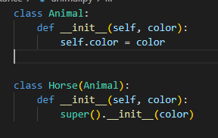
The syntax + further explanation
Animal is a regular class, nothing different.
Horse is followed by parentheses. Inside the parentheses is the class that Horse inherits from.
Horse’s __init__method calls super().
super() is how you reference the base class.
super().__init__() means “call the __init__() method of the Animal class”
Remember to pass in any parameters that the __init__() method of the base class requires (in this case, color)
Notice that Horse does not initialize any attribute for color. Because Horse extends Animal, color automatically becomes an attribute of Horse.

Slide 5
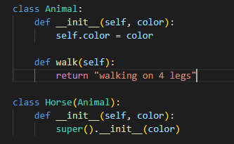

The syntax - for methods also
Just as we saw that color was inherited by the Horse from the Animal, a method can also be inherited.
For example, let’s say our Animal class defines a method walk(). Walk() simply prints “walking on 4 legs”
The Horse class does not define a method walk, because it automatically inherits that method from Animal.
This is what it would look like:
Let’s code these 2 objects and write a main to see how they behave.
https://deepnote.com/workspace/Bassie%20Witkin-511f62db-d864-49b6-b1b3-17e7caebe742/project/Course-2022-85b2d840-de20-4fd8-8c72-2d6b125bac85/notebook/Notebook%201-074292fef11b469f98a54fc2b672bba5

Slide 6
Why?
So far, we’ve seen that the functionality of a derived class can come from it’s base class. That means that if I have 20 different classes of Animals (Dog, Cat, Mouse etc), they simply have to inherit from the Animal class in order to have the shared behavior of an Animal (the attributes and the methods)

Slide 7
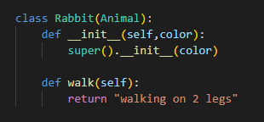
Overriding a base class method in a derived class
Say I have a class rabbit that inherits from Animal. I have a problem. My Rabbit’s walk method should not say “walking on 4 legs” because a rabbit only walks on 2 legs.
Solution: Override the base class’s method by defining a method inside the derived class. The method that is overriding must have:
the same name as the method being overridden
The same number of arguments and the same datatype as the method being overridden
The same return type as the method being overridden
So, our rabbit will also define a method called walk() which accepts 0 parameters and returns a string, just like the walk() method of the Animal class.
Let’s try it out:

Slide 8
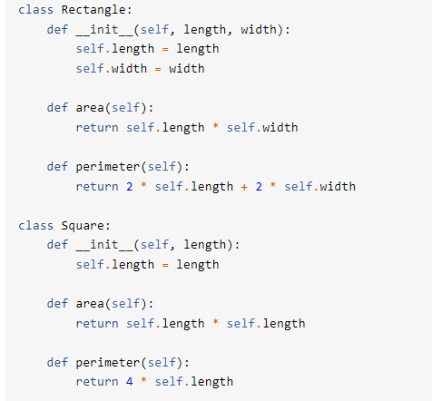
More neat inheritance tricks
Here’s another example (from realipython.com).
Say you have a class Rectangle and a class Square. When you implement the 2 classes, you will notice that a lot of the code looks similar. Actually, in the real world, a square is-a rectangle. Alarm bells! You can use inheritance!
Here’s what the original code would look like without inheritance:

Slide 9
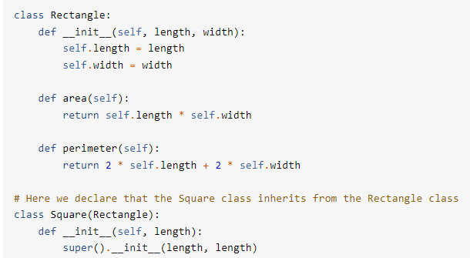
More neat inheritance tricks (cont)
How can we update the code to use inheritance and therefore be less redundant?
We can take the one attribute of square (length) and pass it into the rectangle class 2 times - one for the length and once for the width
Let’s try it out together:

Slide 10
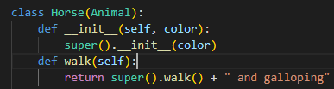
super()
We can also access the methods of the base class from the derived class if we would like to add functionality on top of what the base class is already doing.
For example, if my Animal’s walk method returns “walking on 4 legs”, but my horse wants to return “walking on 4 legs and galloping”, I would override the walk() method of Animal class inside my Horse class and call super().walk() to execute the Animal’s walk method. Then I would add any additional functionality to my Horse’s walk() method.
It would look like this:
Another example this would be useful for: an employee class with a base salary and a CommissionedEmployee derived class who gets the base salary + commission. Using super() enables me not to lose the base salary functionality. Were the base_salary to change for all Employees, only the employee class would have to change, but my ComissionedEmployee class can remain untouched.

Slide 11
Be aware
If the parent class initializes an attribute that is private (double underscore), the derived class will NOT have access to that attribute.
If the parent class initializes an attribute with a single underscore (known as non-public), although we said that it is a bad practice to access any variables with a single underscore from outside the class, it is ok to access that attribute from a derived class.
Let’s illustrate this.

Slide 12
More examples
Can we come up with more examples where inheritance would be useful in classes that we write?

Slide 13
Assignment
Write a class called Family_Member. (make sure you are in a different folder than yesterday’s assignment so that the files do not get confused)
Instance attributes: firstname, lastname, age
Method: babysit(). Returns a string that describes what babysitting constitutes.
Method __str__()
Write a class called Parent that inherits from Family_Member.
Write a class called Child that inherits from Family_Member.
Override the babysit() method. Return a string that describes what babysitting constitutes for any Family_Member (hint- use super()) PLUS any additional description that pertains when a child is carrying out the babysitting.
Please complete for HW if not done in class.

